Slide 1
Cloud Computing

Slide 2
What is Cloud Computing
The term cloud refers to a network or the internet. It is a technology that uses remote servers on the internet to store, manage, and access data online rather than local drives. The data can be anything such as files, images, documents, audio, video, and more.
OR
Cloud Computing is the delivery of computing services such as servers, storage, databases, networking, software, analytics, intelligence, and more, over the Cloud (Internet).

Slide 3
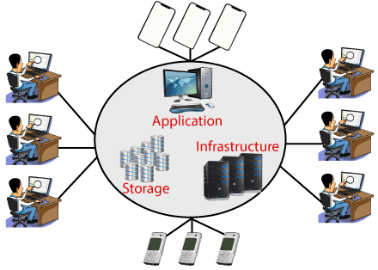

Slide 4
Characteristics of Cloud Computing
The characteristics of cloud computing are given below:
1) Agility
The cloud works in a distributed computing environment. It shares resources among users and works very fast.
2) High availability and reliability
The availability of servers is high and more reliable because the chances of infrastructure failure are minimum.
3) Multi-Sharing
With the help of cloud computing, multiple users and applications can work more efficiently with cost reductions by sharing common infrastructure.

Slide 5
4) Device and Location Independence
Cloud computing enables the users to access systems using a web browser regardless of their location or what device they use e.g. PC, mobile phone, etc. As infrastructure is off-site (typically provided by a third-party) and accessed via the Internet, users can connect from anywhere.
5) Maintenance
Maintenance of cloud computing applications is easier, since they do not need to be installed on each user's computer and can be accessed from different places. So, it reduces the cost also.

Slide 6
6) Low Cost
By using cloud computing, the cost will be reduced because to take the services of cloud computing, IT company need not to set its own infrastructure and pay-as-per usage of resources.

Slide 7
Advantages of cloud computing
Cost: It reduces the huge capital costs of buying hardware and software.
Speed: Resources can be accessed in minutes, typically within a few clicks.
Scalability: We can increase or decrease the requirement of resources according to the business requirements.
Productivity: While using cloud computing, we put less operational effort. We do not need to apply patching, as well as no need to maintain hardware and software. So, in this way, the IT team can be more productive and focus on achieving business goals.
Reliability: Backup and recovery of data are less expensive and very fast for business continuity.
Security: Many cloud vendors offer a broad set of policies, technologies, and controls that strengthen our data security.

Slide 8
Service Providers
Google Cloud
AWS (Amazon web services)
Microsoft Azure
IBM Cloud
Alibaba Cloud
etc……..

Slide 9
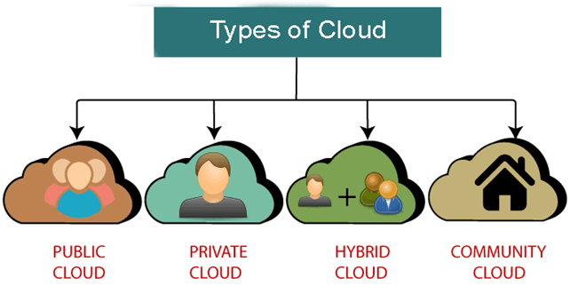

Slide 10
Public Cloud
Public cloud is open to all to store and access information via the Internet using the pay-per-usage method.
In public cloud, computing resources are managed and operated by the Cloud Service Provider (CSP).
Example: Amazon elastic compute cloud (EC2), IBM SmartCloud Enterprise, Microsoft, Google App Engine, Windows Azure Services Platform.

Slide 11
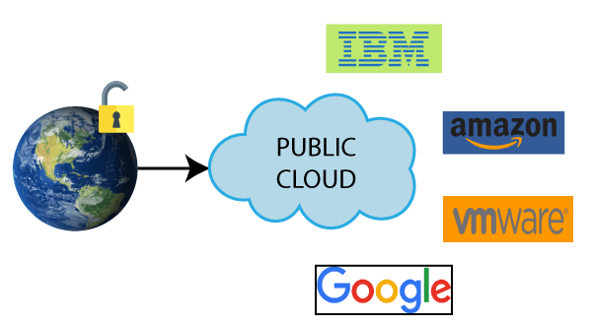

Slide 12
Advantages of Public Cloud
There are the following advantages of Public Cloud -
Public cloud is owned at a lower cost than the private and hybrid cloud.
Public cloud is maintained by the cloud service provider, so do not need to worry about the maintenance.
Public cloud is location independent because its services are delivered through the internet.
Public cloud is highly scalable as per the requirement of computing resources.
It is accessible by the general public, so there is no limit to the number of users.

Slide 13
Disadvantages of Public Cloud
Public Cloud is less secure because resources are shared publicly.
Performance depends upon the high-speed internet network link to the cloud provider.
The Client has no control of data.

Slide 14
Private Cloud
Private cloud is also known as an internal cloud or corporate cloud. It is used by organizations to build and manage their own data centers internally or by the third party..

Slide 15
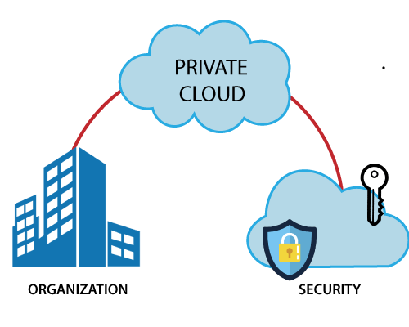

Slide 16
Advantages of Private Cloud
There are the following advantages of the Private Cloud -
Private cloud provides a high level of security and privacy to the users.
Private cloud offers better performance with improved speed and space capacity.
It allows the IT team to quickly allocate and deliver on-demand IT resources.
The organization has full control over the cloud because it is managed by the organization itself. So, there is no need for the organization to depends on anybody.
It is suitable for organizations that require a separate cloud for their personal use and data security is the first priority.

Slide 17
Disadvantages of Private Cloud
Skilled people are required to manage and operate cloud services.
Private cloud is accessible within the organization, so the area of operations is limited.
Private cloud is not suitable for organizations that have a high user base, and organizations that do not have the prebuilt infrastructure, sufficient manpower to maintain and manage the cloud.

Slide 18
Hybrid Cloud
Hybrid Cloud is a combination of the public cloud and the private cloud. we can say:
Hybrid Cloud = Public Cloud + Private Cloud
Hybrid cloud is partially secure because the services which are running on the public cloud can be accessed by anyone, while the services which are running on a private cloud can be accessed only by the organization's users.
Example: Google Application Suite (Gmail, Google Apps, and Google Drive), Office 365 (MS Office on the Web and One Drive), Amazon Web Services.

Slide 19
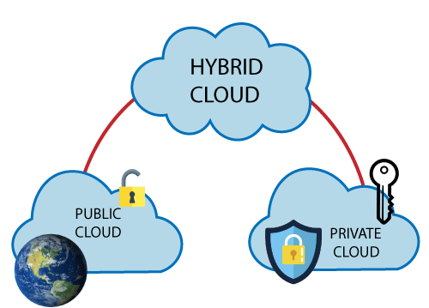

Slide 20
Advantages of Hybrid Cloud
There are the following advantages of Hybrid Cloud -
Hybrid cloud is suitable for organizations that require more security than the public cloud.
Hybrid cloud helps you to deliver new products and services more quickly.
Hybrid cloud provides an excellent way to reduce the risk.
Hybrid cloud offers flexible resources because of the public cloud and secure resources because of the private cloud.

Slide 21
Disadvantages of Hybrid Cloud
In Hybrid Cloud, security feature is not as good as the private cloud.
Managing a hybrid cloud is complex because it is difficult to manage more than one type of deployment model.
In the hybrid cloud, the reliability of the services depends on cloud service providers.

Slide 22
Community Cloud
Community cloud allows systems and services to be accessible by a group of several organizations to share the information between the organization and a specific community. It is owned, managed, and operated by one or more organizations in the community, a third party, or a combination of them.
Example: Health Care community cloud

Slide 23
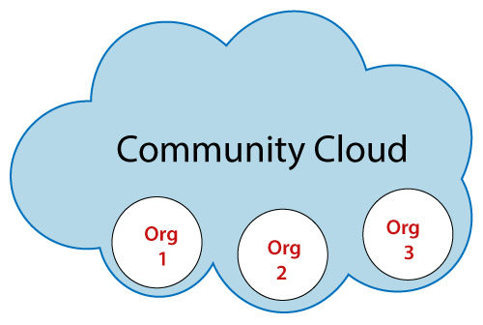

Slide 24
Advantages of Community Cloud
There are the following advantages of Community Cloud -
Community cloud is cost-effective because the whole cloud is being shared by several organizations or communities.
Community cloud is suitable for organizations that want to have a collaborative cloud with more security features than the public cloud.
It provides better security than the public cloud.
It provdes collaborative and distributive environment.
Community cloud allows us to share cloud resources, infrastructure, and other capabilities among various organizations.

Slide 25
Disadvantages of Community Cloud
Community cloud is not a good choice for every organization.
Security features are not as good as the private cloud.
It is not suitable if there is no collaboration.

Slide 26
Cloud Service Models
There are the following three types of cloud service models -
Infrastructure as a Service (IaaS)
Platform as a Service (PaaS)
Software as a Service (SaaS)

Slide 27
